Slide 1

ECSE231L : Probability and Statistics
Descriptive Statistics

Slide 2
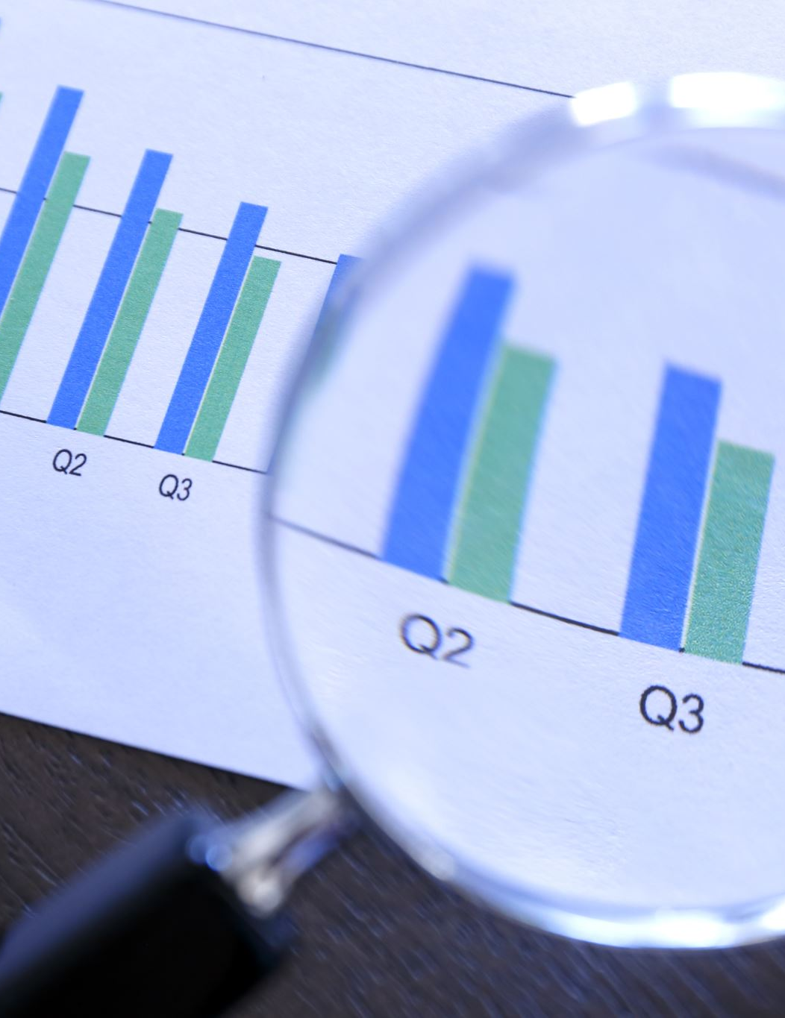
Statistics
Art of learning from data.
Concerned with data collection, organization, its description and its analysis and finally drawing conclusions from it.

Slide 3
Data collection
Survey forms, questionnaires, interviews, documents and reports
Must be random

Slide 4
Descriptive statistics
Concerned with describing and summarizing the data
Tables and graphs are used for data presentation and helps user quickly grasp the essential characteristics of it. Like range of data, symmetry of data, etc

Slide 5
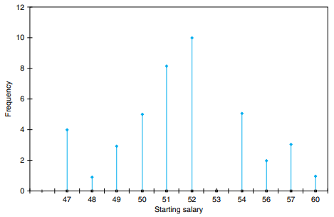
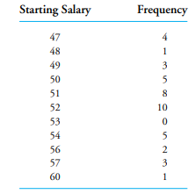
Frequency tables and line graphs
Used to present data set with small number of distinct values
Example: Data set consisting of yearly salaries of 42 graduates

Slide 6
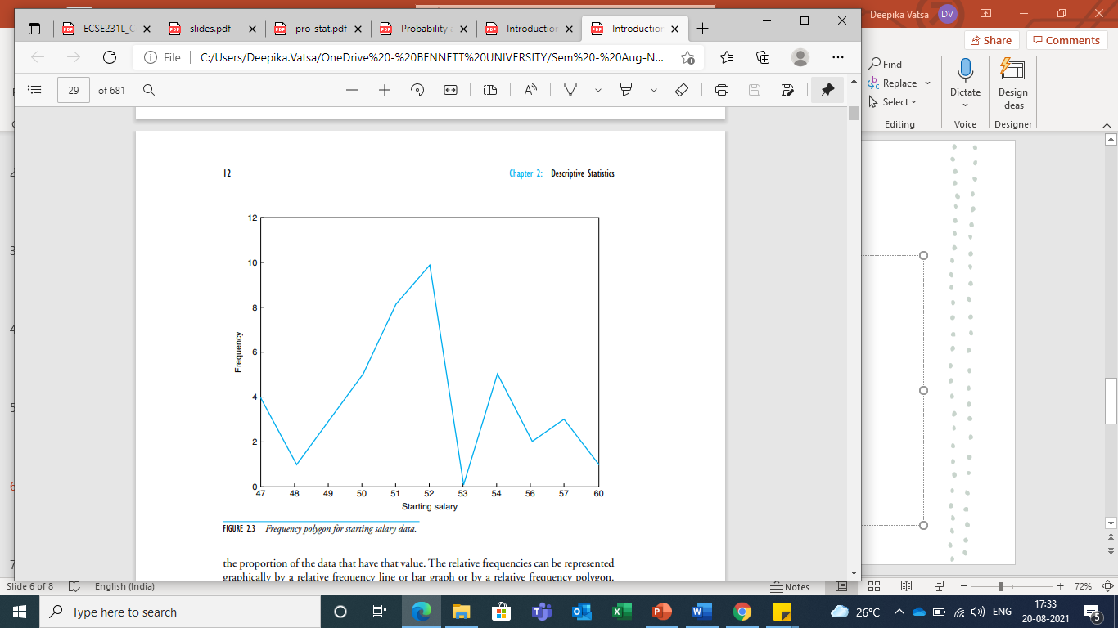
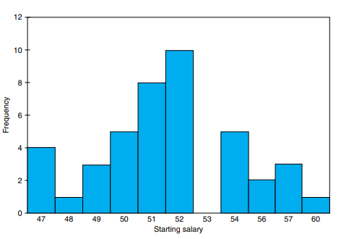
Bar plots and frequency polygons

Slide 7
Relative frequency
Consider a data set having n values and f is the frequency of a particular value, then the ratio f/n is known as relative frequency.
Example, Data set = {a1, a2, a3, a1, a1, a4, a1, a1, a9, a5}
So here, value ‘a1’ occurs 5 times, f(a1) = 5/10 = 0.5
So relative frequency mainly shows data proportion.

Slide 8
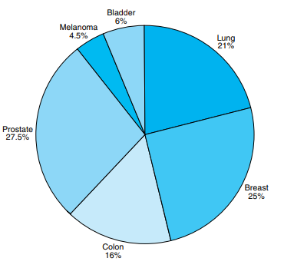
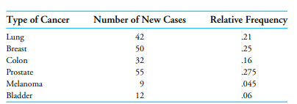
Pie Chart
A Pie chart is used to present relative frequencies when data is not numerical.

Slide 9
Histogram
In case of data sets where the number of distinct values is too large, it is useful to divide the values into groupings, or class intervals, and then plot the number of data values falling in each class interval
Number of class intervals is a subjective choice
Class interval [100,200] has class boundaries 100 and 200 (end points) and include data values between 100 to 199
A bar graph plot of class data, with the bars placed adjacent to each other, is called a histogram. Vertical axis may show frequency or relative frequency

Slide 10
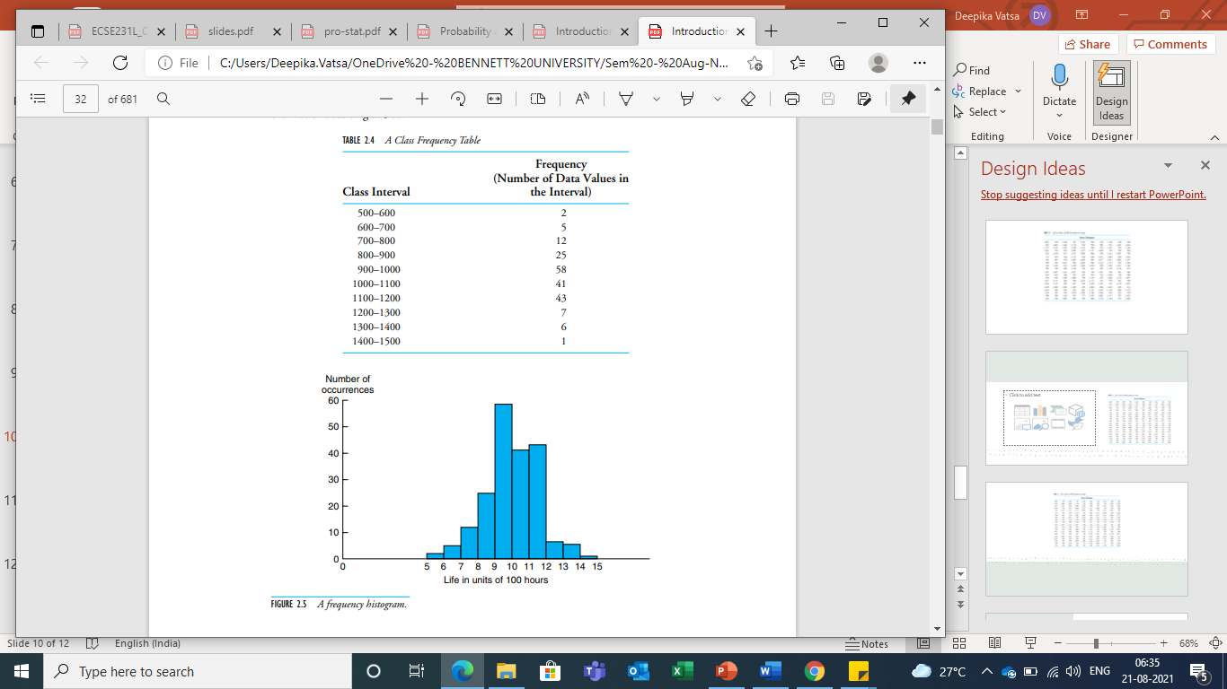
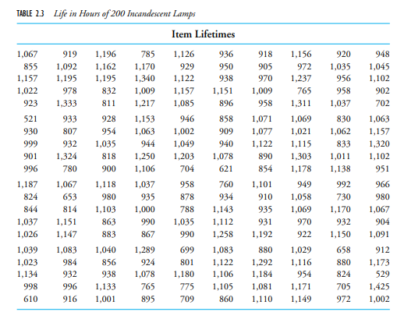

Slide 11
Bar plot vs Histogram
Histogram | Bar plot
Show distribution of variables | Used to compare variables
Plot quantitative data grouped in bins/class intervals | Plot categorical data
Bars cannot be reordered | Bars can be reordered
https://www.forbes.com/sites/naomirobbins/2012/01/04/a-histogram-is-not-a-bar-chart/?sh=241648fa6d77

Slide 12
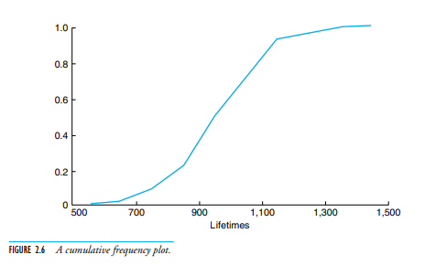
Cumulative frequency graph (Ogive)
A point on the horizontal axis represents a possible data value; its corresponding vertical plot gives the number (or proportion in case of relative frequency) of the data whose values are less than or equal to it.

Slide 13
Population and Sample
In statistics, we want to obtain information about a total collection of elements. This total collection of elements is called population.
Population is often too large to examine each of its members
So, we choose a subgroup of its elements and examine them. This subgroup of population is known as a sample.
The sample should be drawn randomly and should be representative of the entire population (only then it will be informative about the whole population).

Slide 14
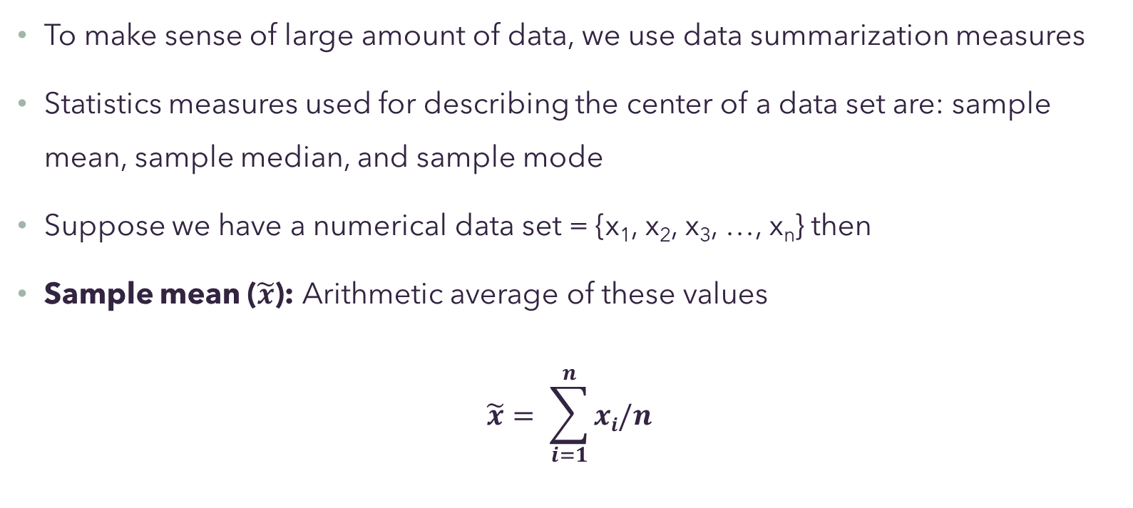
Data Summarization
To make sense of large amount of data, we use data summarization measures
Statistics measures used for describing the center of a data set are: sample mean, sample median, and sample mode
Suppose we have a numerical data set = {x₁, x₂, x₃, …, x_{n}} then
Sample mean ($\tilde{x}$): Arithmetic average of these values
$$\tilde{x}= \sum_{i=1}^{n}{xi/n}$$

Slide 15
To compute weighted average, each observation/data point is multiplied by the assigned weight which is then summed and divided by the number of data points.
When weights equals the number of occurrence, arithmetic mean is the same as weighted mean.

Slide 16
Sample median: middle value when the data set is arranged in increasing order
If data set contains odd number of values, median is the value at position (n+1)/2. If data set contains even number of values, median is the average of values at positions n/2 and (n/2+1).
Example: Data set = {12,14,7,9,3,15}
Sorted data set = {3, 7,9,12,14,15}
Sample median = (9+12)/2 = 10.5

Slide 17
Both sample mean and sample median are used to describe the central tendency of a data set.
While the sample mean is affected by the extreme values, sample median will be unaffected by it since it is mainly considers middle values.
Sample mode: The data value that occurs with the greatest frequency. If no single value occurs most frequently, then all the values that occur at the highest frequency are called modal values.

Slide 18
Consider two data sets D1 and D2
D1 = {1,3,5,7,9} and D2 = {-5,0,5,10,15}
Mean(D1) = Mean(D2) = 5
But are the two data sets same?

Slide 19
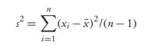
Sample variance
Statistic measure to describe the spread or variability of the data values
Computed as:
The calculation of variance uses squares because it weighs outliers more heavily than data closer to the mean. This calculation also prevents differences above the mean from canceling out those below, which would result in a variance of zero.
Positive square root of the variance is standard deviation (s)
Standard deviation is measured in the same units as the data

Slide 20
Percentile and Boxplot
Sample x percentile of a data is that data value such that x% of the data values are less than or equal to it or (100-x)% are greater than or equal to it.
Sample 50 percentile is sample median
Sample 25 percentile, 50 percentile and 75 percentile makes up sample quartiles. Four quartiles in total.
A boxplot plots summarizing statistics of a data set, that is, four quartiles

Slide 21
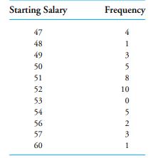
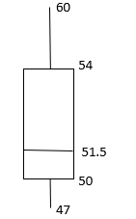
Box plot contains a straight line stretching from the smallest to the largest data value; imposed on the line is a “box”, which starts at the first and continues to the third quartile, with the value of the second quartile indicated by a vertical line.
The length of the box itself, equal to the third quartile minus the first quartile, is called the interquartile range.

